Slide 1
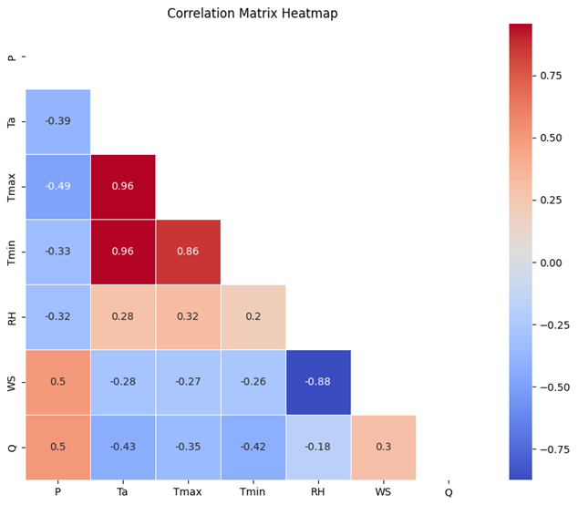
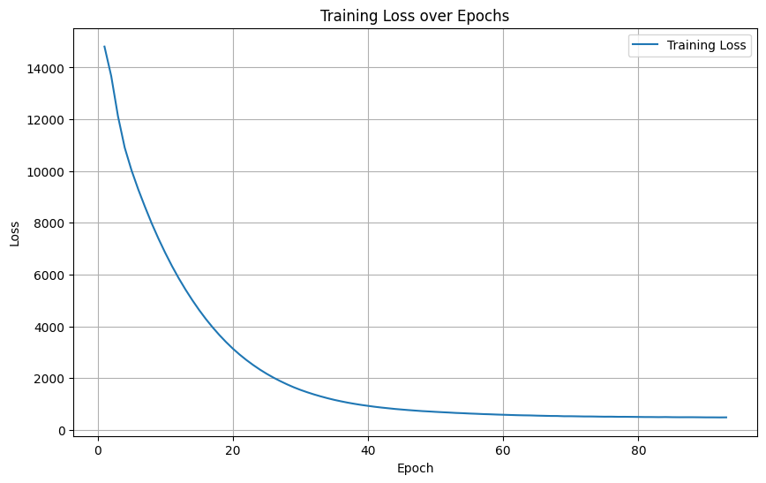
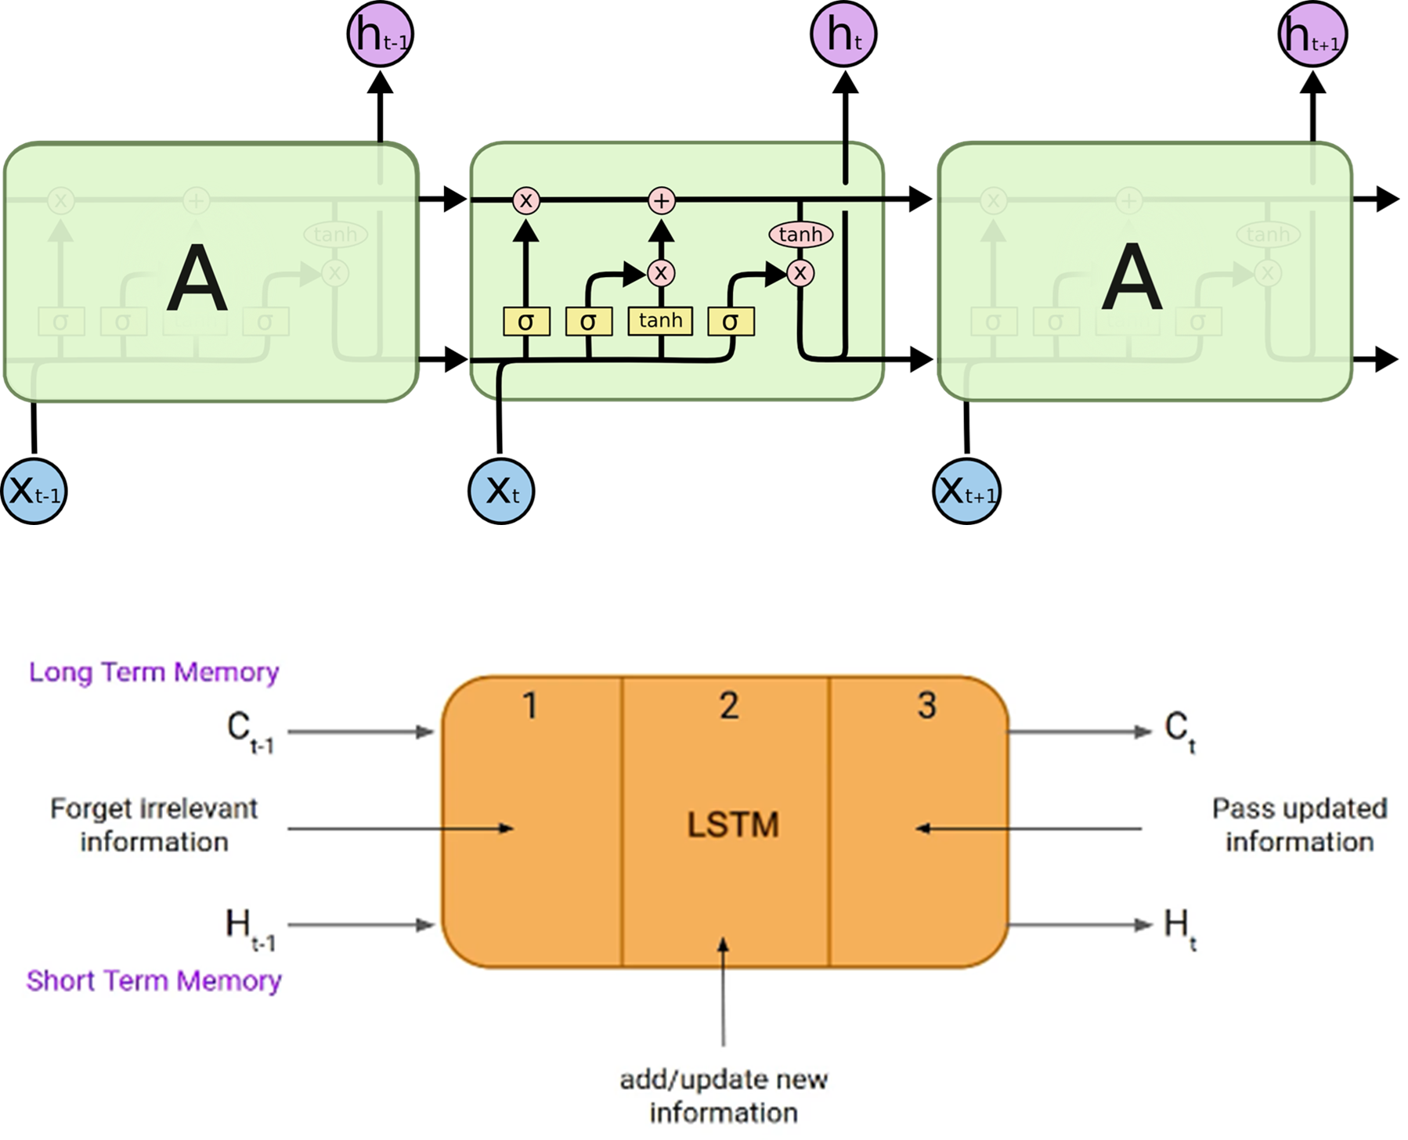
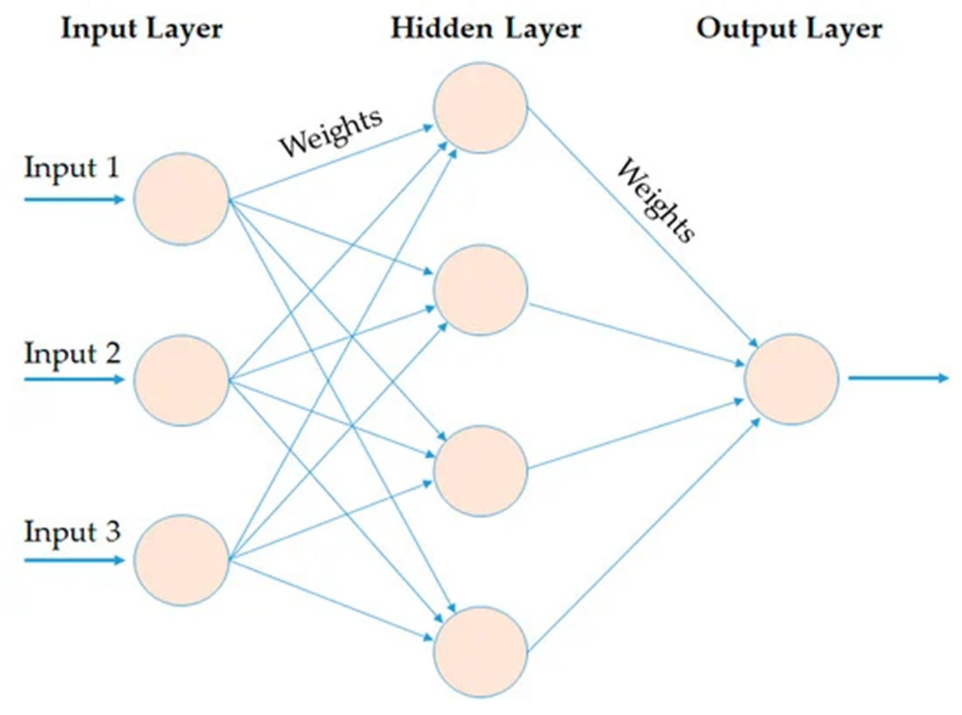
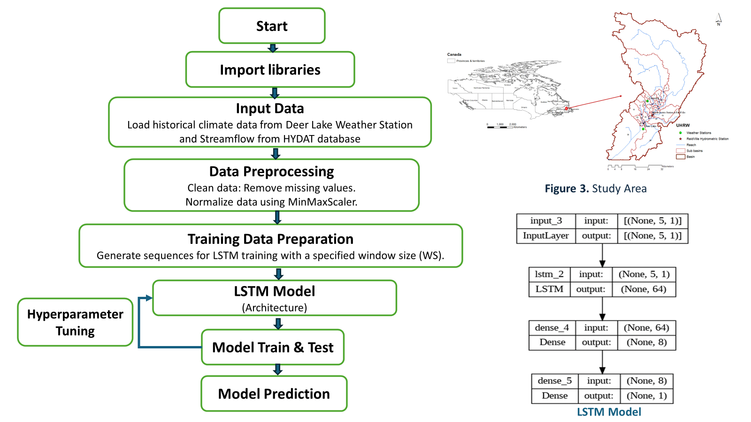
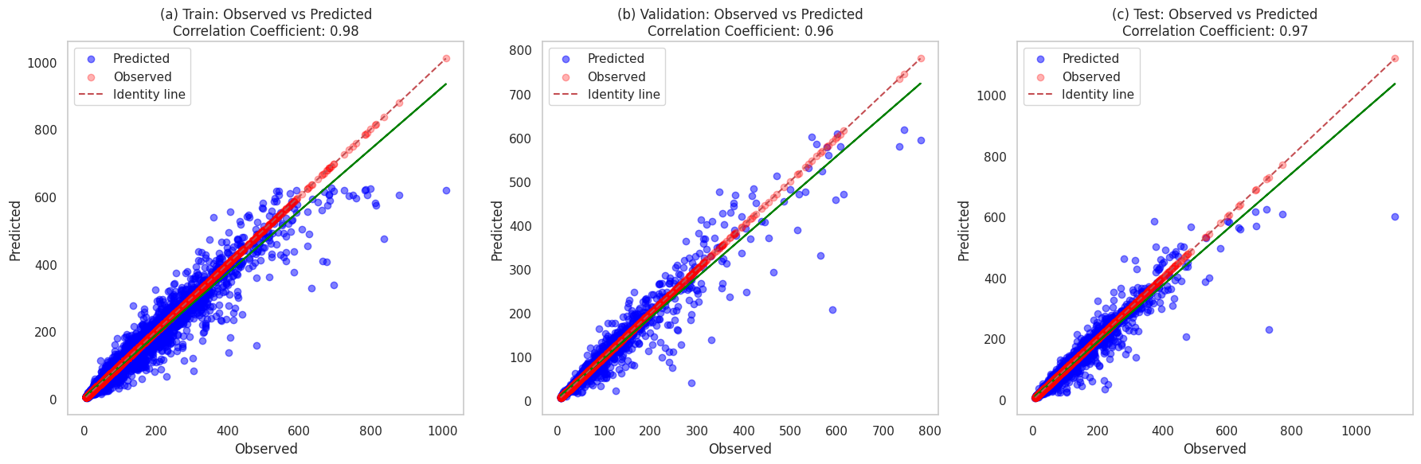
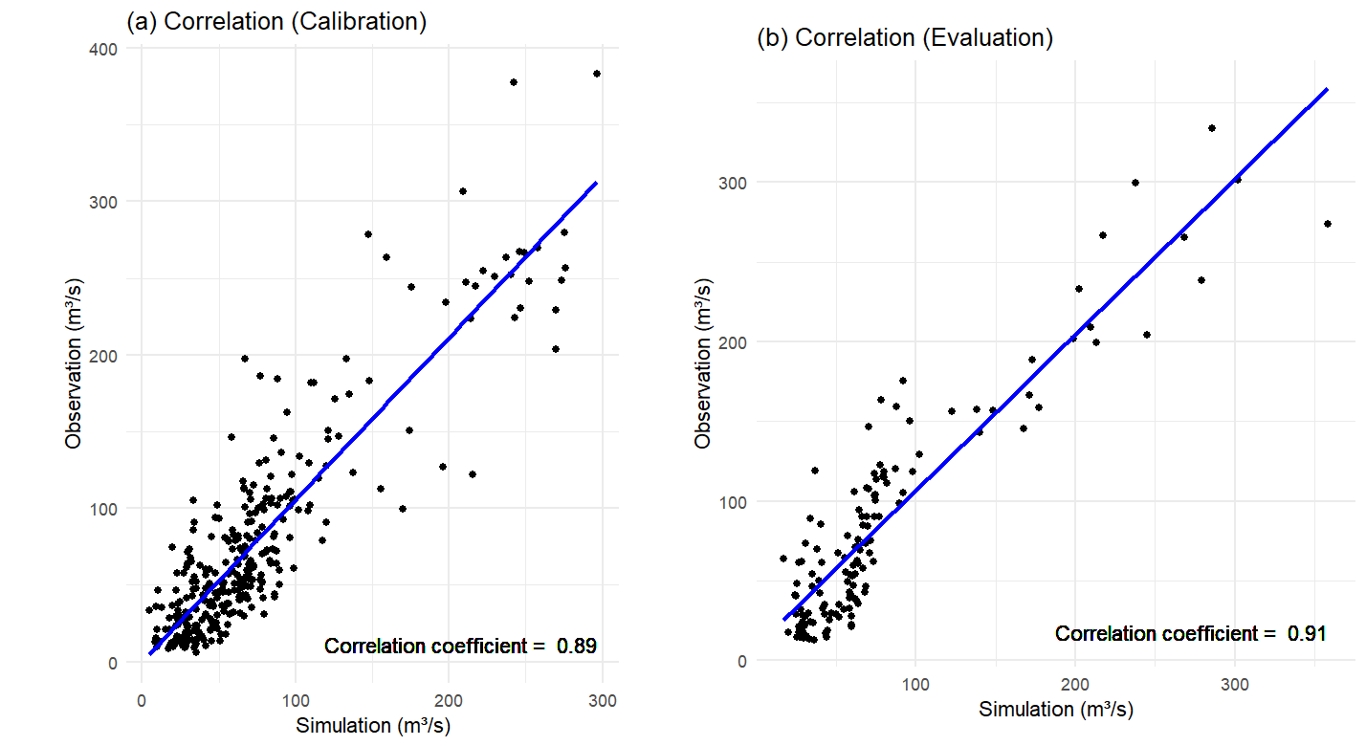
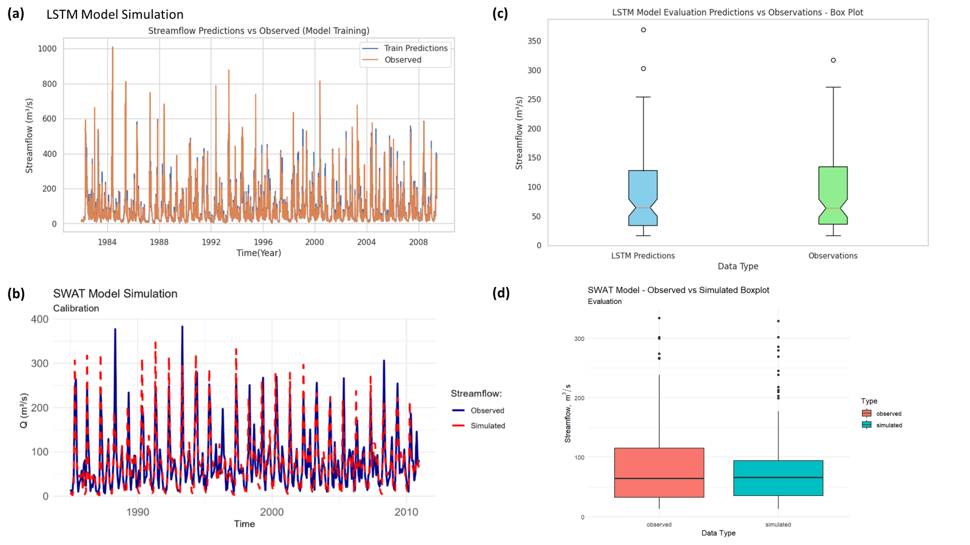
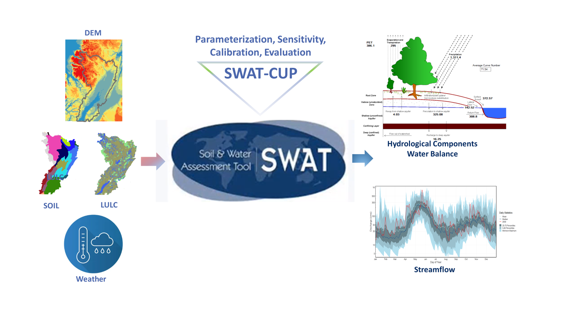




A comparative evaluation of streamflow prediction using the SWAT model and artificial intelligence model in the Upper Humber River Watershed, NL, Canada
Kamal Islam¹ , Lakshman Galagedara¹ , Joseph Daraio² , Mumtaz Cheema¹ , Gabriela Sabau¹
¹School of Science and the Environment, Memorial University of Newfoundland, Corner Brook, NL, Canada
²Faculty of Engineering and Applied Science, Memorial University of Newfoundland, St. John’s, NL, Canada
Introduction
Results
Streamflow forecasting is crucial for water management, including flood control¹ and drought² mitigation. Traditional hydrological models struggle with capturing the complexities of hydrological processes due to their limitations with nonlinear relationships. In contrast, deep learning models, particularly Long Short-Term Memory networks, excel in handling long-term dependencies and nonlinear patterns in data ³.
Long Short-Term Memory (LSTM) is a type of recurrent neural network (RNN) architecture designed to capture long-term dependencies in sequential data, often used in natural language processing and time series prediction tasks⁴.
Speech recognition tasks leverage LSTMs for accurately transcribing spoken language and effectively handling long sequences, powering major systems like Apple's Siri, Microsoft's Cortana, and Amazon's Alexa⁵. Additionally, LSTMs are adept at time series prediction, forecasting forthcoming data points in series such as stock prices, weather patterns, and other time-dependent datasets⁴.
Objectives:
Develop an LSTM model for forecasting streamflow in the Upper Humber River, Newfoundland.
Evaluate the performance of the LSTM model for streamflow forecasting.
Compare the LSTM model with the previously calibrated SWAT model to determine relative performance and accuracy.
The features considered precipitation (P), mean temperature (Ta), maximum temperature (Tmax), minimum temperature (Tmin), relative humidity (RH), wind speed (WS), and streamflow (Q).
Q shows a strong correlation with P and Ta.
LSTM model input features - P and Ta
output feature - Q
Figure 5. Heatmap showing the correlations between climate variables and streamflow.
LSTM Model Architecture
LSTM model learns from data.
Loss reduces over epochs.
LSTM consists of a series of cells, each containing three gates (input, forget, and output gates) that regulate the flow of information and maintain a cell state.
Table 1: LSTM Model Evaluation Metrics
Evaluation Metrics | Training | Validation | Test
Nash-Sutcliffe Efficiency (NSE) | 0.95 | 0.93 | 0.93
Root Mean Squared Error (RMSE) | 20.91 | 24.22 | 24.42
Mean Absolute Error (MAE) | 8.60 | 10.21 | 9.68
Coefficient of Determination (R²) | 0.95 | 0.93 | 0.93
Figure 1. Schematic of a typical Artificial Neural Network (ANN) architecture
Figure 2. The Long Short-Term Memory (LSTM) neural network.
Figure 6. LSTM model learns from data and reduces loss over epochs.
Methodology
LSTM Model
Figure7. Correlation between actual streamflow and data during training (a), validation (b), and testing (c) periods (LSTM model).
SWAT Model
Figure 8. Correlation between actual and simulated streamflow and data during (a) calibration, and (b) evaluation periods (SWAT model)
Figure 9. LSTM and SWAT model Hydrograph and Box plot comparing the actual flow values with the predicted flow values.
LSTM demonstrates superior performance compared to SWAT in terms of correlation coefficients (Figures 7 and 8 ).
A comparison of time series hydrograph and box plot analyses between observed and predicted values from LSTM and SWAT models (Figure 9 ). This comparison highlights the models' accuracy and variability in predictions.
Conclusion & Future Direction
LSTM models demonstrate robust predictive capabilities for streamflow forecasting in the Upper Humber River Watershed. However, data-driven models like LSTM are limited in their ability to simulate other hydrological variables, unlike hydrological models such as SWAT model.
Future research should prioritize the following areas :
Integration of Real-Time Data: Incorporating real-time data concerning behavior of the stream flow under human impact , such as pollution.
Figure 4 SWAT model for the Upper Humber River Watershed⁶.
References
Acknowledgement
LSTM Model code GitHub link
Contact
(1) Girihagama et al (2022) Neural Comput & Applic, https://doi.org/10.1007/s00521-022-07523-8
(2) Hunt et al. (2022) . Hydrology and Earth System Sciences, https://doi.org/10.5194/hess-26-5449-2022
(3) Shekar et al (2023) Water Infrastructure, Ecosystems and Society, https://doi.org/10.2166/aqua.2023.048
(4) Van Houdt et al (2020) . Artif Intell Rev, https://doi.org/10.1007/s10462-020-09838-1
Hoy, M. B. (2018) Alexa, Siri, Cortana, and More: An Introduction to Voice Assistants. Med Ref Serv Q, https://doi.org/10.1080/02763869.2018.1404391.
Islam et al (2024) Environ. Res. Commun. 6 055017, DOI 10.1088/2515-7620/ad495c
Kamal Ziaul Islam
Transdisciplinary Sustainability Doctoral Candidate
School of Science & the Environment, Grenfell Campus, Memorial University of Newfoundland
Email: kzislam@mun.ca, kamalziaulislam@yahoo.com
Funding: Industry, Energy and Technology of the Government of NL (IET Grant: 5404-1962-102) and Memorial University of Newfoundland and Labrador.
Collaborators: Department of Fisheries, Forestry and Agriculture, Government of Newfoundland and Labrador.
SWAT Model info GitHub link

